Slide 1

WAY TO ENTERPRISE
Pakage 1: Database

Slide 2
WAY TO ENTERPRISE
Lesson 2

Slide 3
Agenda
Datatype
Constraints
Assignments
Copyright © VTI Academy All Rights Reserved

Slide 4
Datatype
Number
String (characters)
Date & Time
ENUM

Slide 5
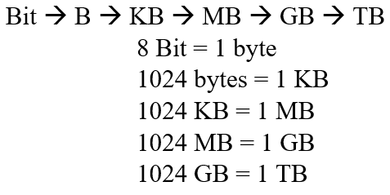
Memory Size

Slide 6
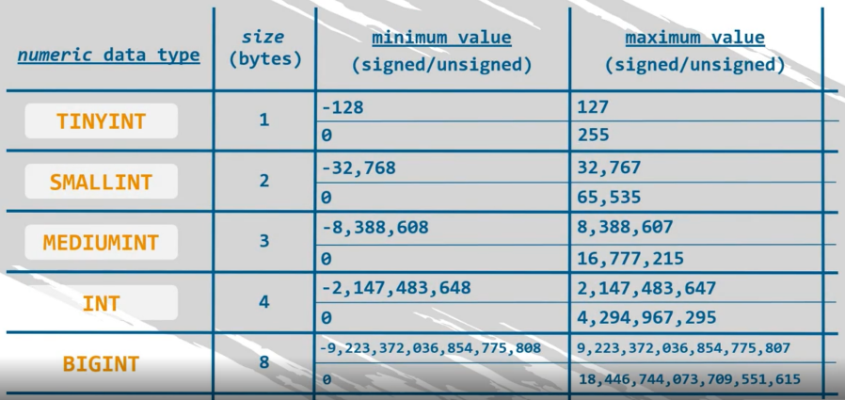
Number

Slide 7
Number
Float (4 bytes)
Double (8 bytes)

Slide 8
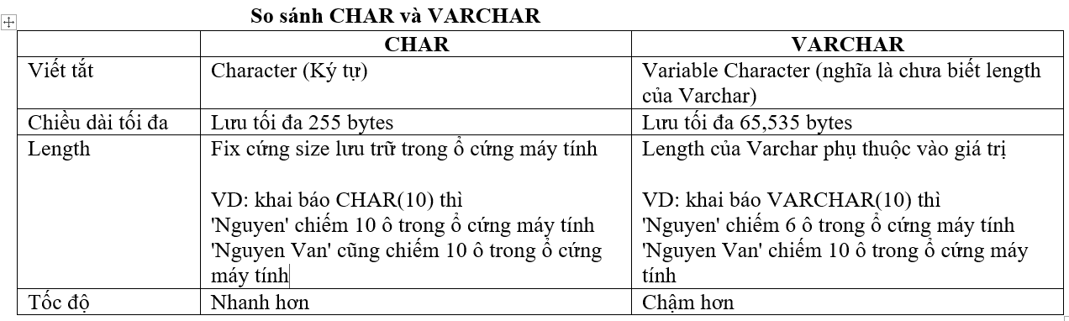
String (characters)

Slide 9
Date & Time
Date: yyyy-mm-dd
Time : hh:mm:ss
Datetime: yyyy-mm-dd hh:mm:ss

Slide 10
ENUM
Ex: ENUM ('Male', 'Female')

Slide 11
Create Database
DROP DATABASE [IF EXISTS] database_name;
CREATE DATABASE [IF NOT EXISTS] database_name;

Slide 12
Create Table
DROP TABLE IF EXISTS table_name;
CREATE TABLE table_name (
name_column_1 datatype constraints,
name_column_2 datatype constraints,
);

Slide 13
Constraints
Primary Key
Foreign Key
Unique Key
Default
Not Null
Check

Slide 14
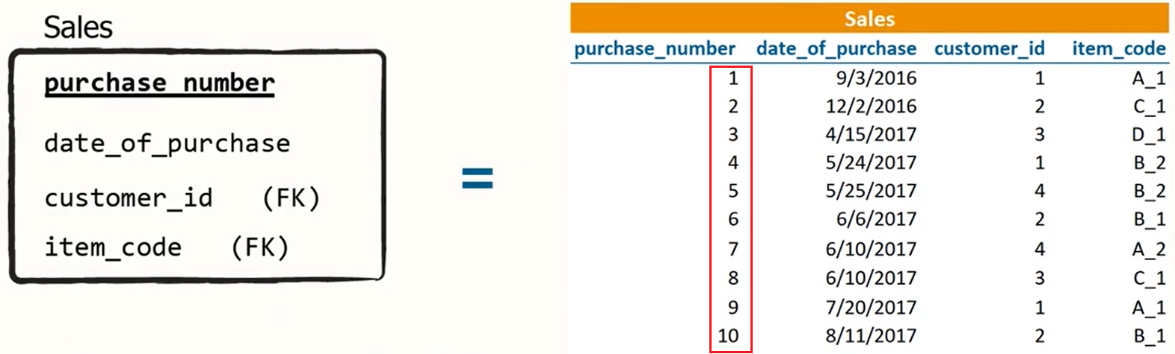
Primary Key

Slide 15
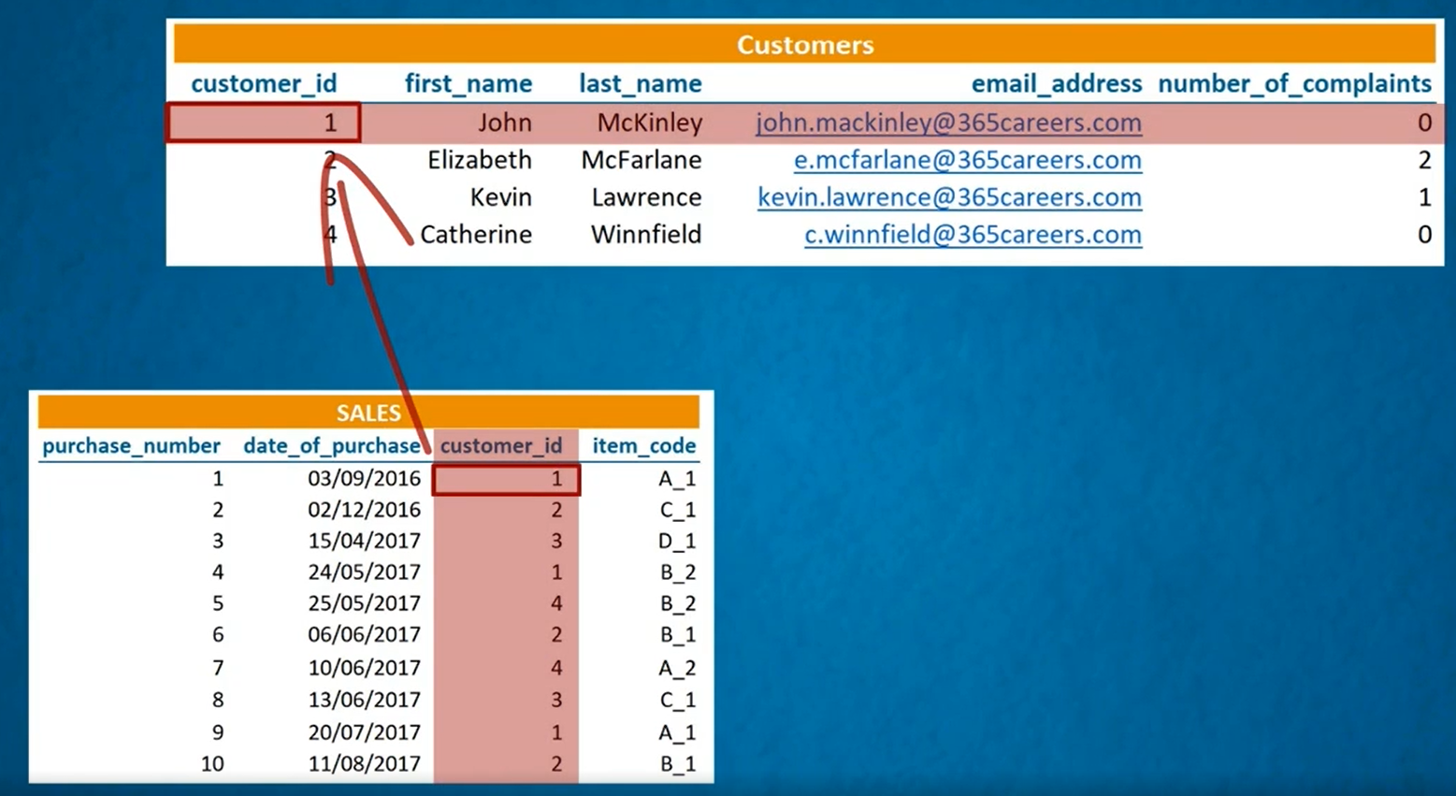
Foreign Key

Slide 16
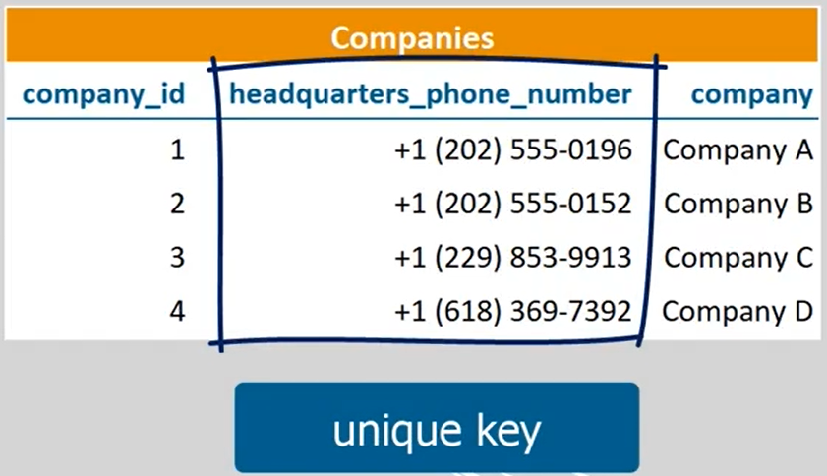
Unique Key

Slide 17
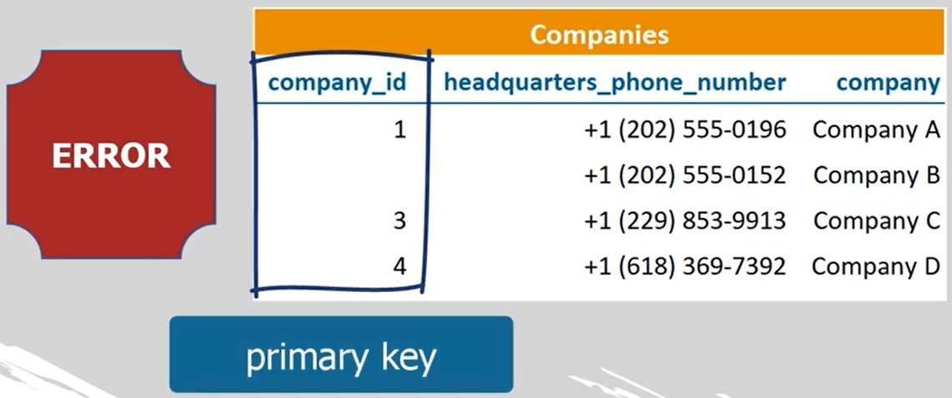
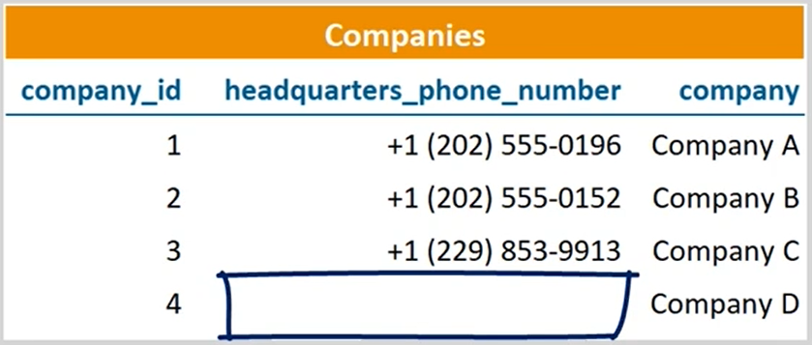
Unique Key & Primary Key
Primary Key
Unique Key

Slide 18
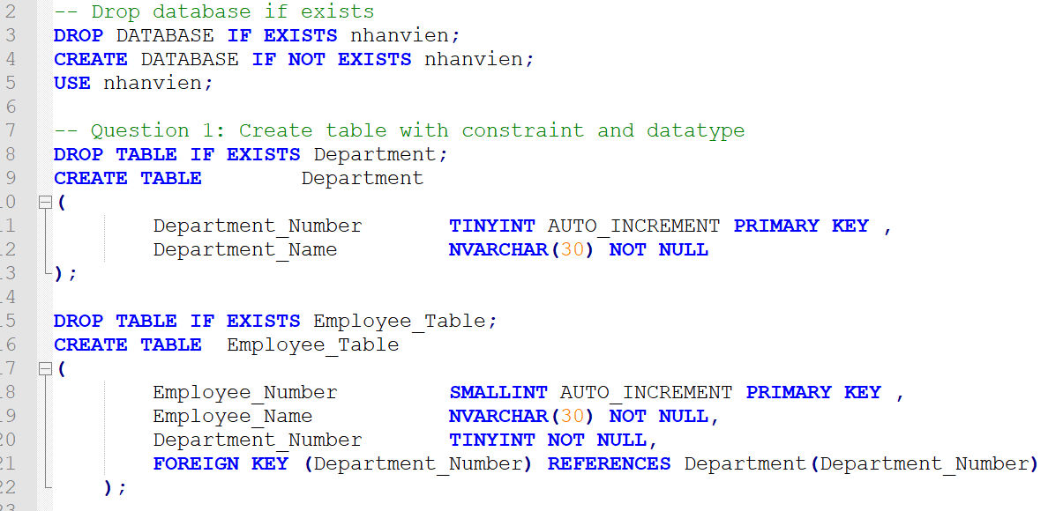
SQL Statement Template

Slide 19
Coding Convention
Reference: https://www.sqlstyle.guide/

Slide 20
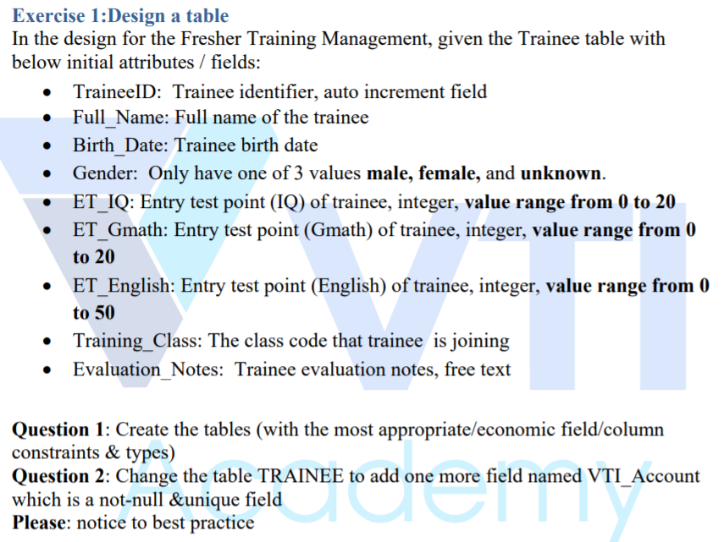
Assignments 1

Slide 21
Assignments 2
Assignment for Testing System

Slide 22
Q & A
Copyright © VTI Academy All Rights Reserved

